Slide 1

Predicting a proportion:
RENEWABLE
ENERGY IN
TOTAL ENERGY CONSUMPTION

Slide 2

table of contents.
01
INTRODUCTION
04
ASSOCIATION
02
DATA CLEANING
05
GBM DIAGRAM
03
REGRESSION ANALYSIS
06
CONCLUSION

Slide 3

Introduction:
Investigate the factors influencing the proportion of energy demand that each nation satisfies through the use of renewable energy.
Data Selection:
The dataset spans across diverse geographical locations.
Predictors:
Primary energy consumption per capita, % population’s access to electricity (or clean fuel), Energy Intensity (The ratio of energy use to GDP ), GDP per capita
Problem Statement:
Our goal is to determine which factors drive nations to use renewable energy at higher rates
Approach:
Regression, Association Analysis, Gradient Boosting
Potential Benefits:
Our findings have the potential to guide policymakers, businesses, and communities towards more effective strategies for promoting renewable energy deployment .
Introduction

Slide 4


Data
Cleaning Process
Data Import & Cleanup:
Import CSV into R Studio.
Remove columns with blank cells.
Eliminate rows with blank entries.
2. Subset and Standardization:
Define the 'y2019' subset that only includes observations from 2019.
Rename columns for clarity and conciseness.
Fix the 'density' column by removing commas to satisfy a numeric form.

Slide 5



Model Construction
Significance Testing
Performance Evaluation
Constructing individual models with "RenewShare" regressed over each predictor, one at a time.
Predictors with p-values > 0.05 will be removed to retain only significant variables.
RMSE will be compared to assess model accuracy.
Confidence Intervals
Graphical Analysis
Establishing confidence intervals to gauge the uncertainty around our model estimates.
Using graphical analysis and transformations to make our results easier to understand.
Regression
Analysis

Slide 6
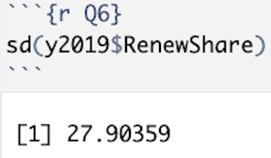
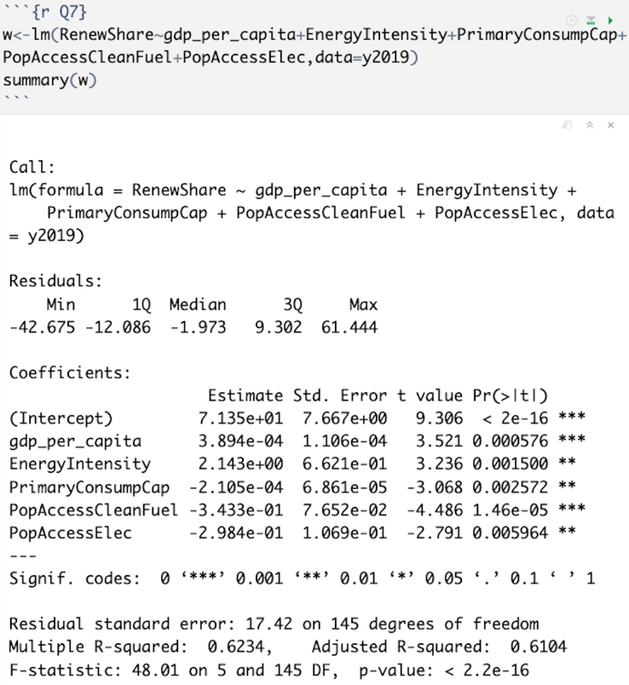
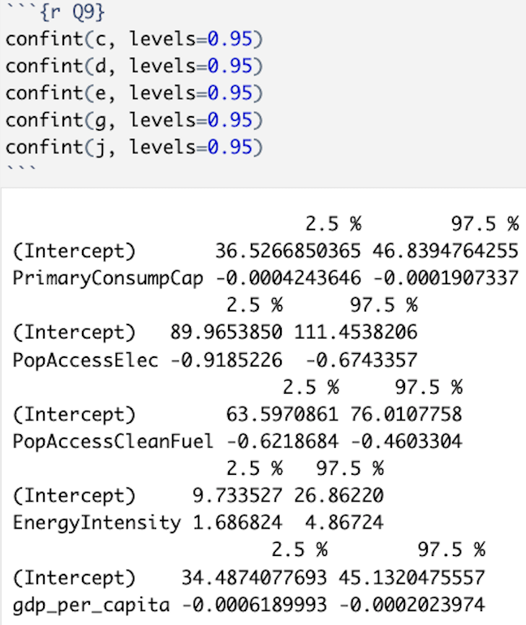
Regression Analysis

Slide 7

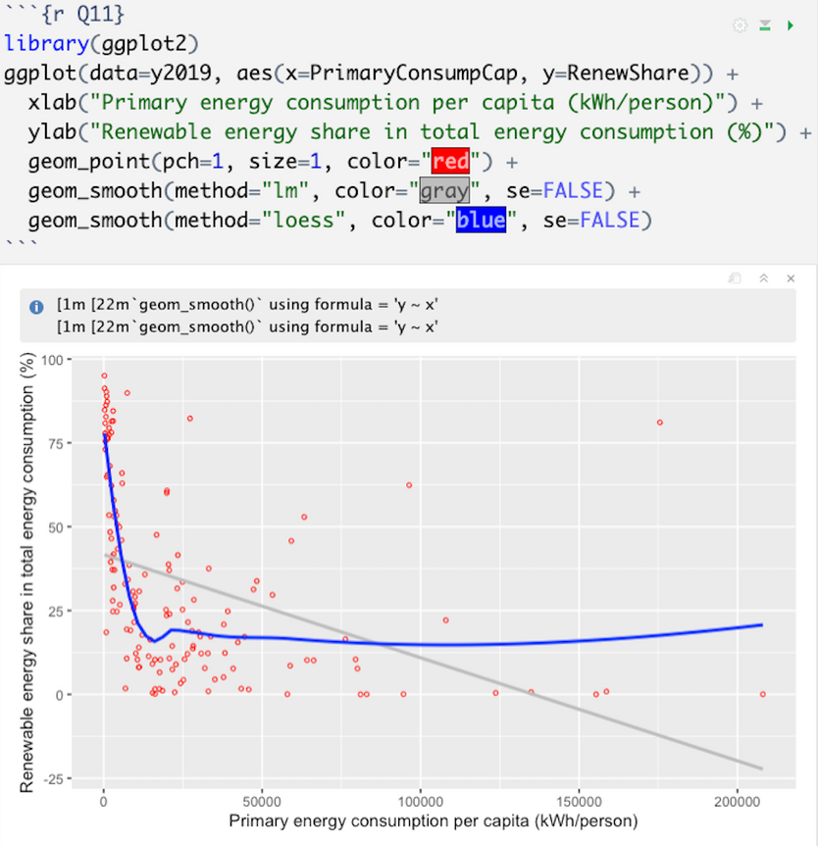
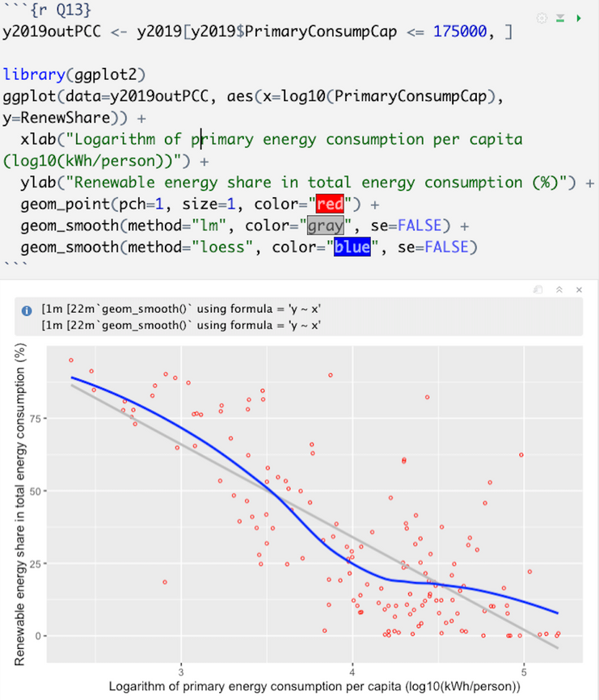
Regression Models - ggplots
Non-ellipsoidal so can’t use Pearson
Nonmonotonic so can’t use Spearman
Pearson & Spearman OK

Slide 8
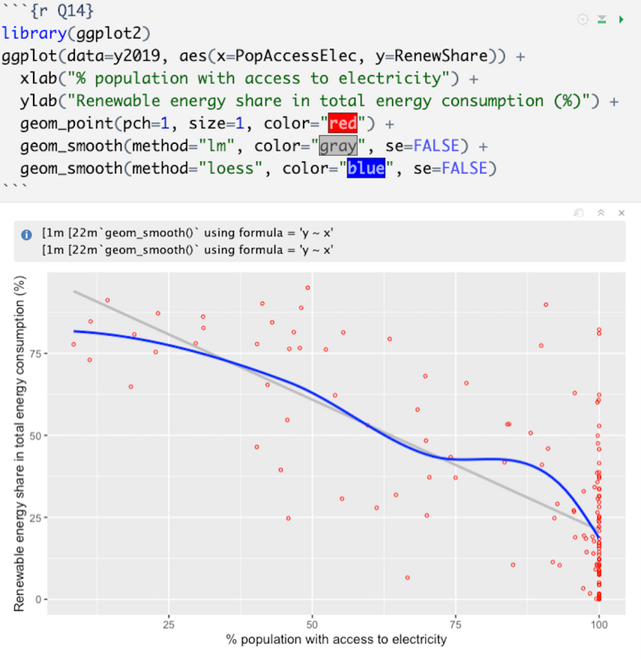
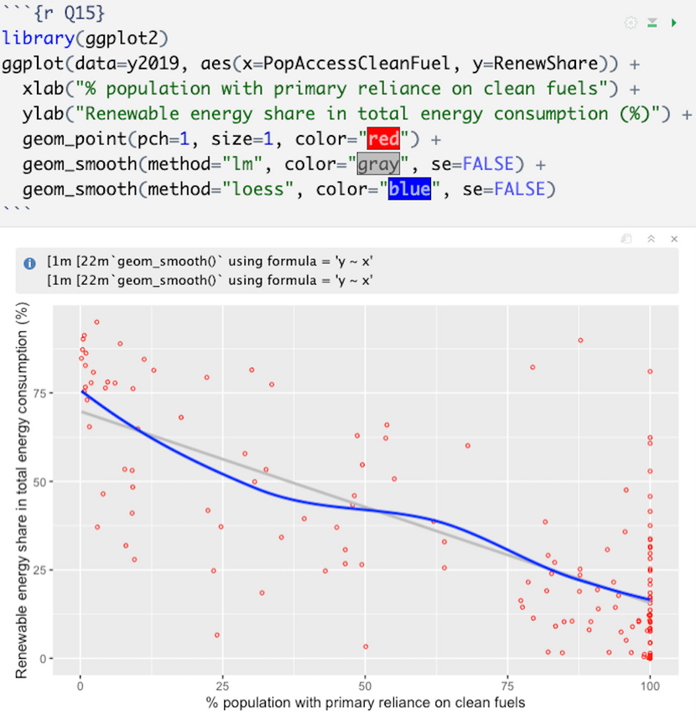
Regression Models - ggplots
Non-ellipsoidal so can’t use Pearson
Nominally monotonic so CAN use Spearman
Non-ellipsoidal so can’t use Pearson
Nominally monotonic so CAN use Spearman

Slide 9
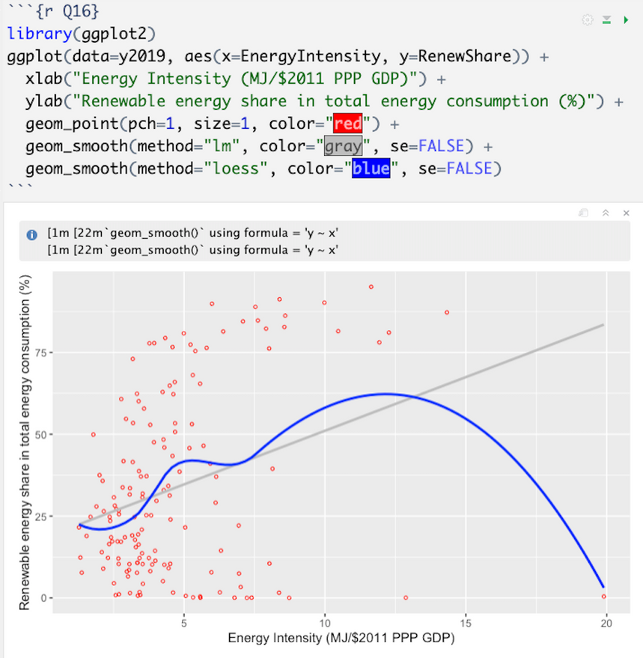
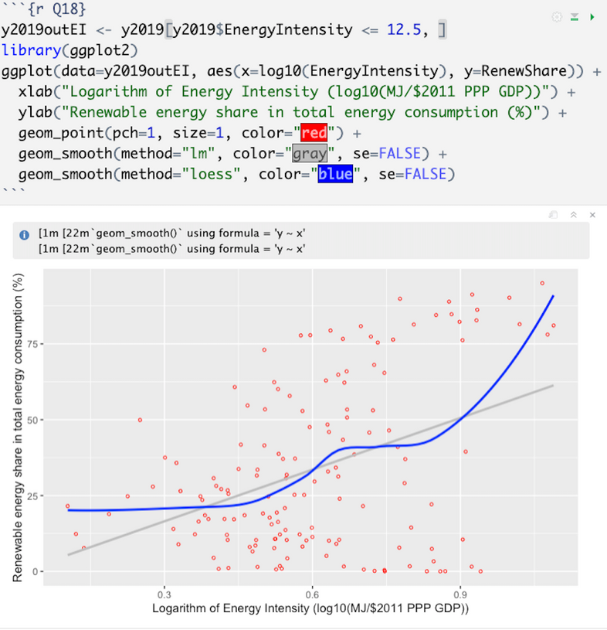
Regression Models - ggplots
Non-ellipsoidal so can’t use Pearson
Nonmonotonic so can’t use Spearman
Pearson & Spearman OK

Slide 10
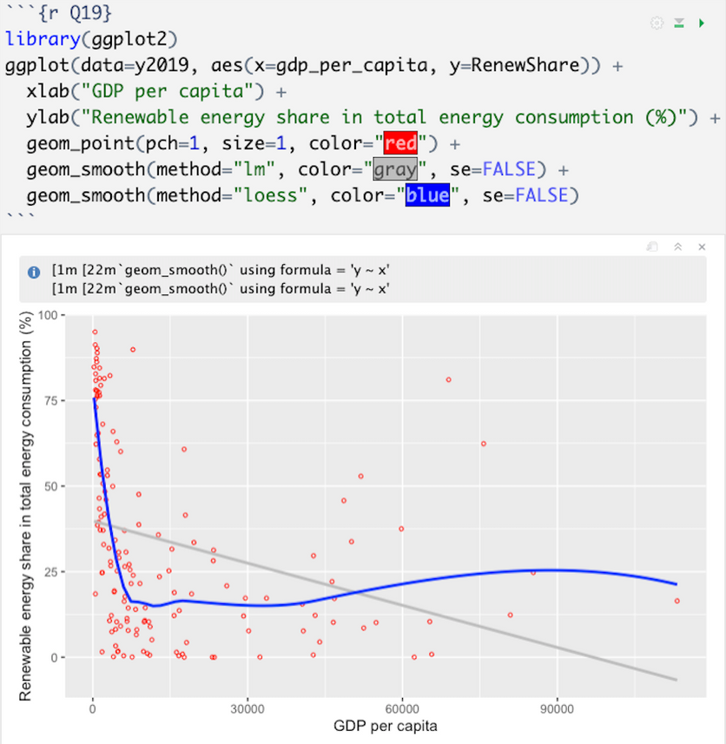
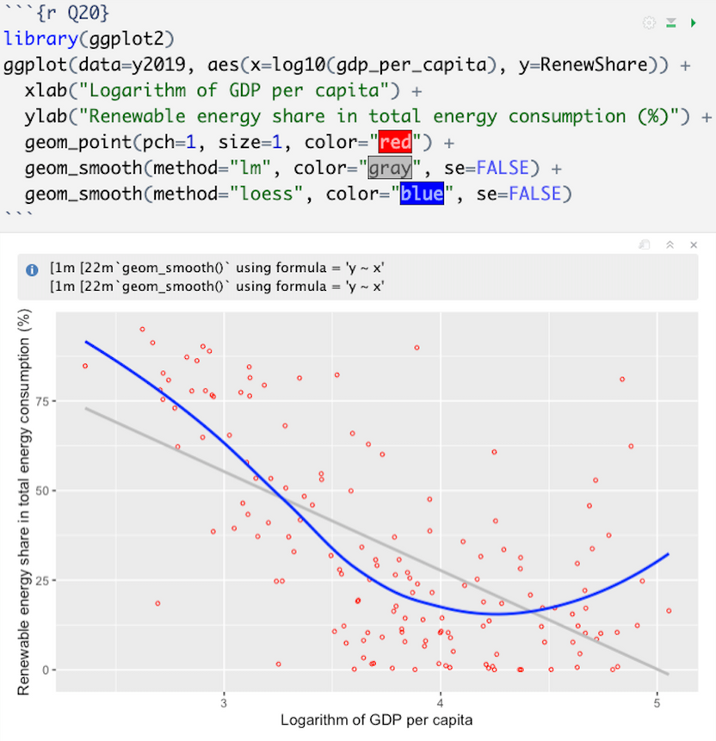
Regression Models - ggplots
Non-ellipsoidal so can’t use Pearson
Nonmonotonic so can’t use Spearman
Pearson OK

Slide 11




Association
Correlation Analysis :
Assessing Pearson and/or Spearman correlations for each relationship based on graphical analysis.
Analysis
Significance Testing :
Correlations for each predictor had p-value ranges of 0 - 0.007 < 0.05
Chance Values Plots :
SSE reductions far beyond what happens “by chance”
Strength Assessment: :
R-squared if Pearson was appropriate, otherwise, defer to graphical analysis

Slide 12
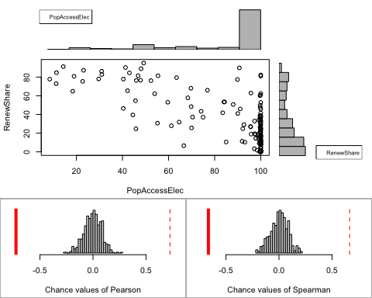
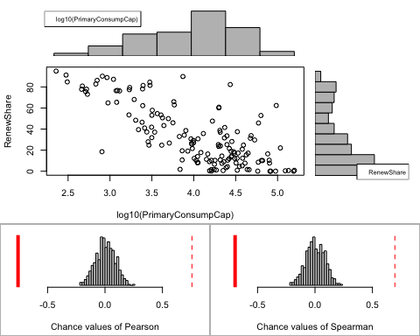
Association Analysis
RenewShare~PopAccessElec
RenewShare~
log10(PrimaryConsumpCap)

Slide 13
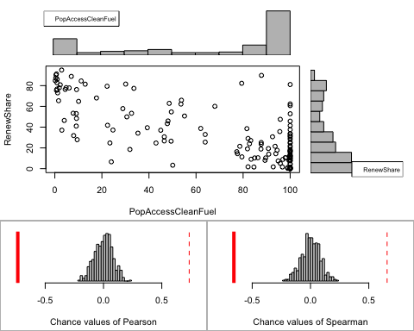
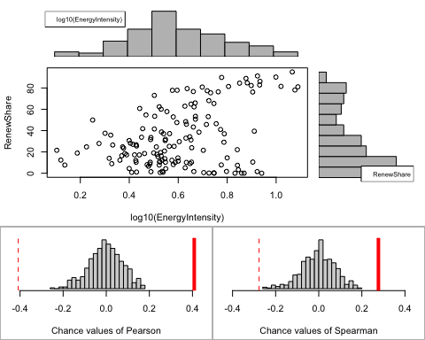
Association Analysis
RenewShare~PopAccessCleanFuel
RenewShare ~
log10(EnergyIntensity)

Slide 14
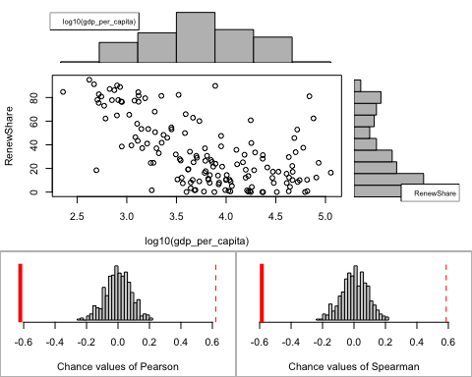
Association Analysis
RenewShare~log10(GDP_Per_Capita)

Slide 15

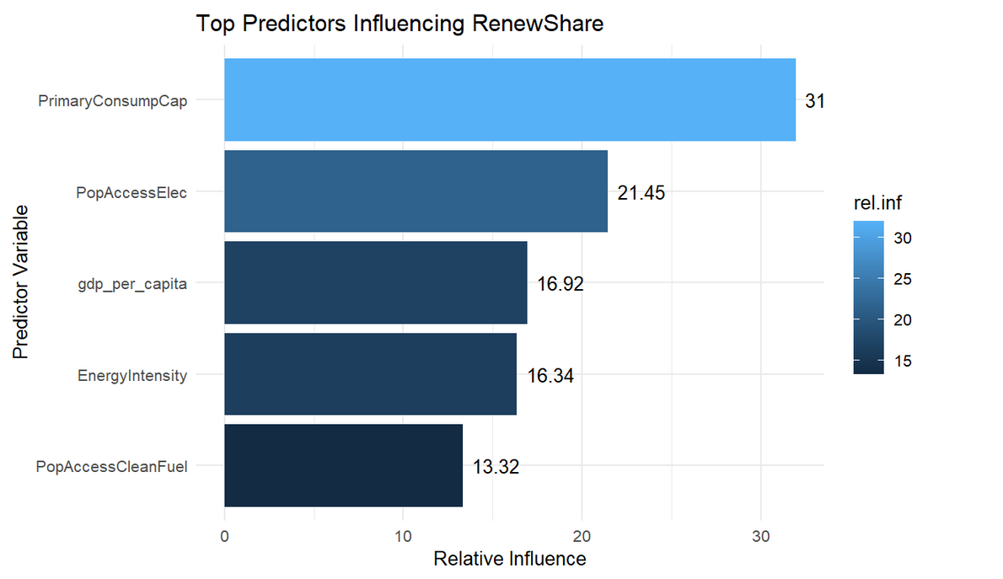
Other Technique: Gradient Boosting Machines (GBM)
Predictor Importance
Powerful machine learning algorithm
Aims to identify the most influential predictors for our Response Variable
By evaluating how often each predictor is used in splitting data and if it significantly decreases prediction error when used for splitting.

Slide 16

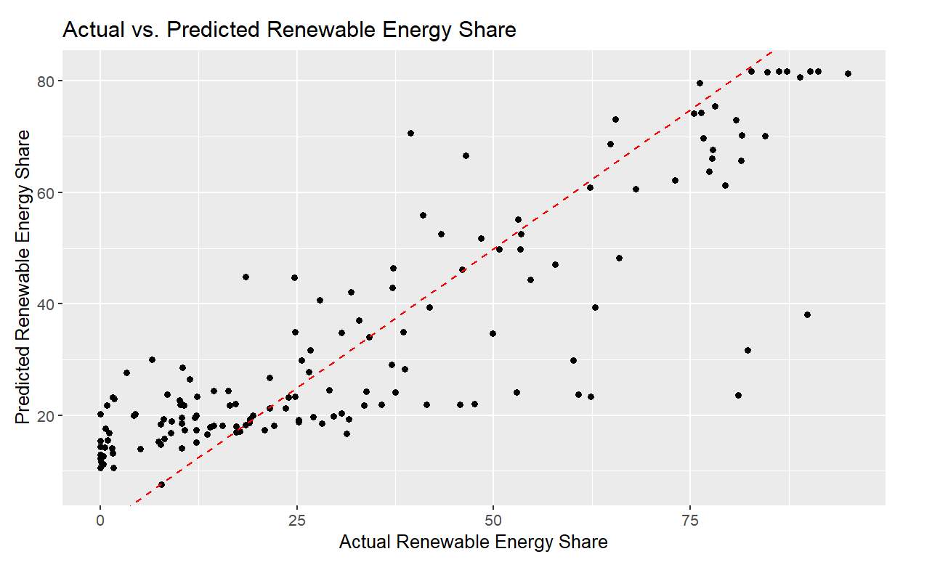
Gradient Boosting Machines (GBM)
Model Importance
Capturing the variation in RenewShare: It means how accurately the model predicts changes in the response variable (RenewShare) using the top predictor variables.
R-squared: 0.7256 model explains 72.56% of the variance in Renewable Energy Share (RenewShare) -which further means that the model can reliably predict changes in RenewShare based on the selected predictors.

Slide 17


GBM: Primary energy consumption per capita (kWh/person): Regions with high energy consumption per capita often have the infrastructure, resources, and policies to support renewable energy, leading to a greater share of its usage.
Conclusion

